Slide 1
ELECTRICAL
MONTHLY BREAKDOWN
ANALYSIS
AREA: Plant 2 Preparation
EQUIPMENT: BANNER CUTTER

Slide 2
LIST OF BREAKDOWNS AT YOUR AREA
In A Excel format Machine wise

Slide 3
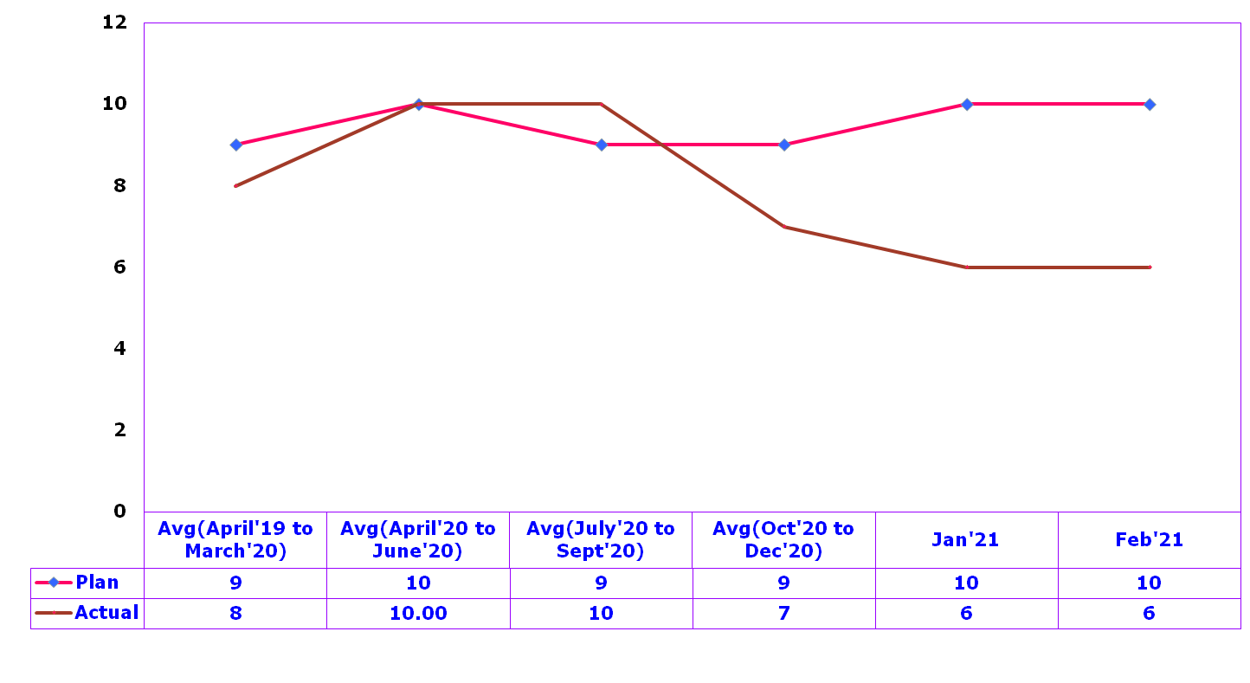
Department –PREPARATION
Department | ENGINEERING | Process Measure | Equipment maintenance
Section | Banner cutter | Unit of Measurement | NO OF OCCASSIONS
Process Model Ref | S6
Occasions (Nos.)

Slide 4
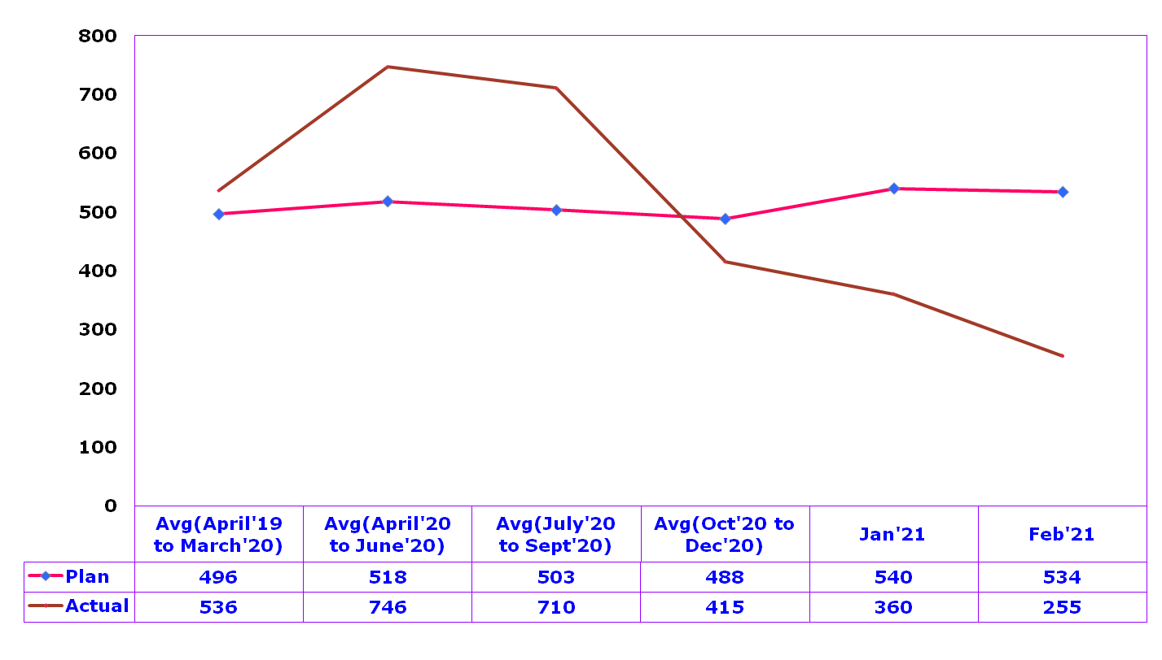
Department –PREPARATION
Department | ENGINEERING | Process Measure | Equipment maintenance
Section | Banner cutter | Unit of Measurement | Time (Minutes)
Process Model Ref | S6
Time (Minutes)

Slide 5
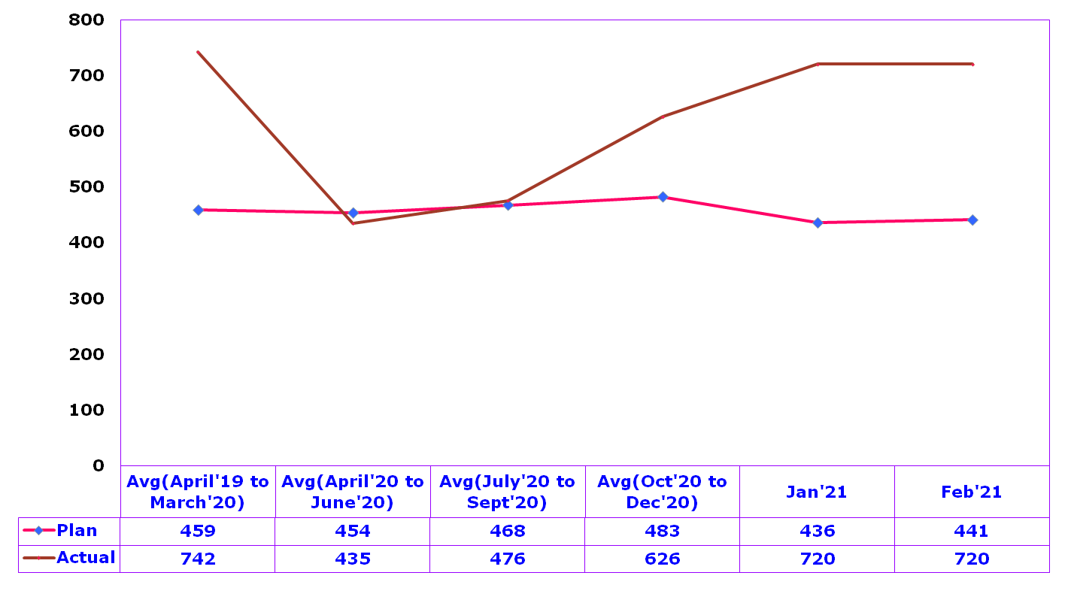
Department –PREPARATION (MTBF)
Department | ENGINEERING | Process Measure | MTBF
Section | Banner cutter | Unit of Measurement | NO OF Hours
Process Model Ref | S6
MTBF (Hours)

Slide 6
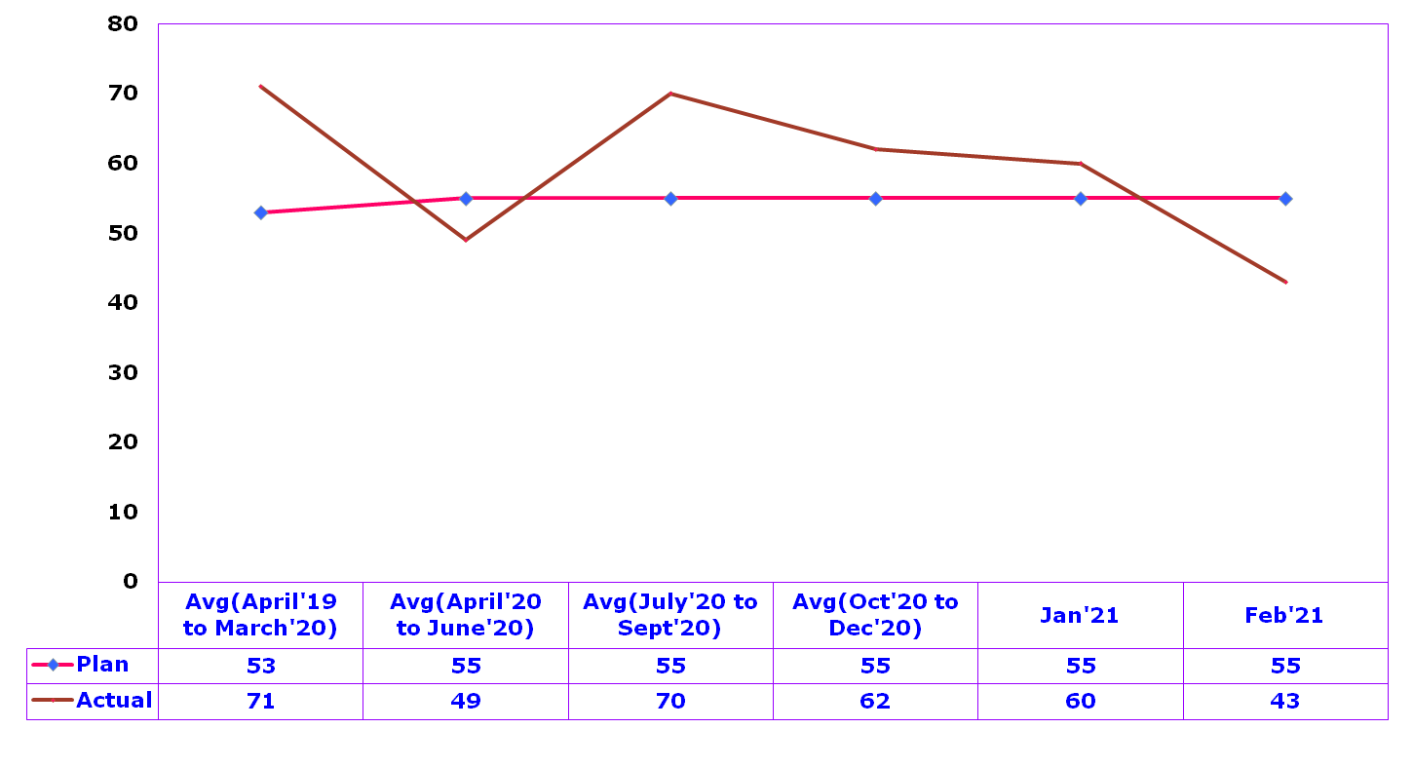
Department – PREPARATION(MTTR)
Department | ENGINEERING | Process Measure | MTTR
Section | Banner cutter | Unit of Measurement | NO OF Minutes
Process Model Ref | S6
MTTR (Minutes)

Slide 7
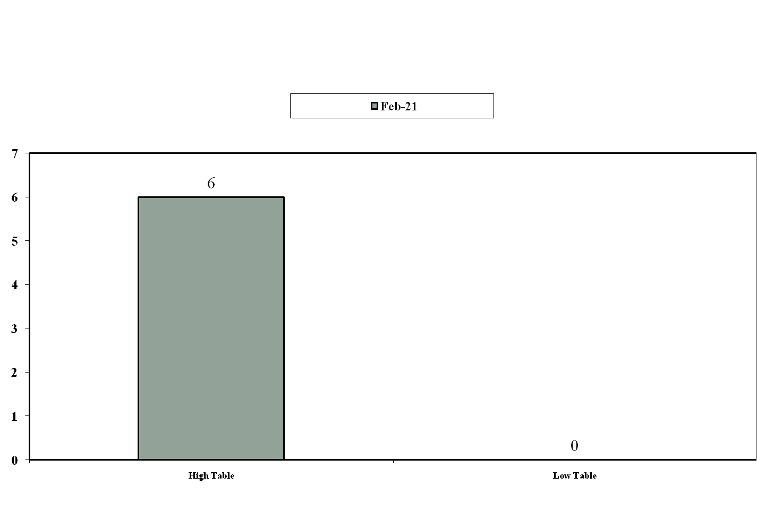
Segment wise parato analysis for Banner cutters

Slide 8
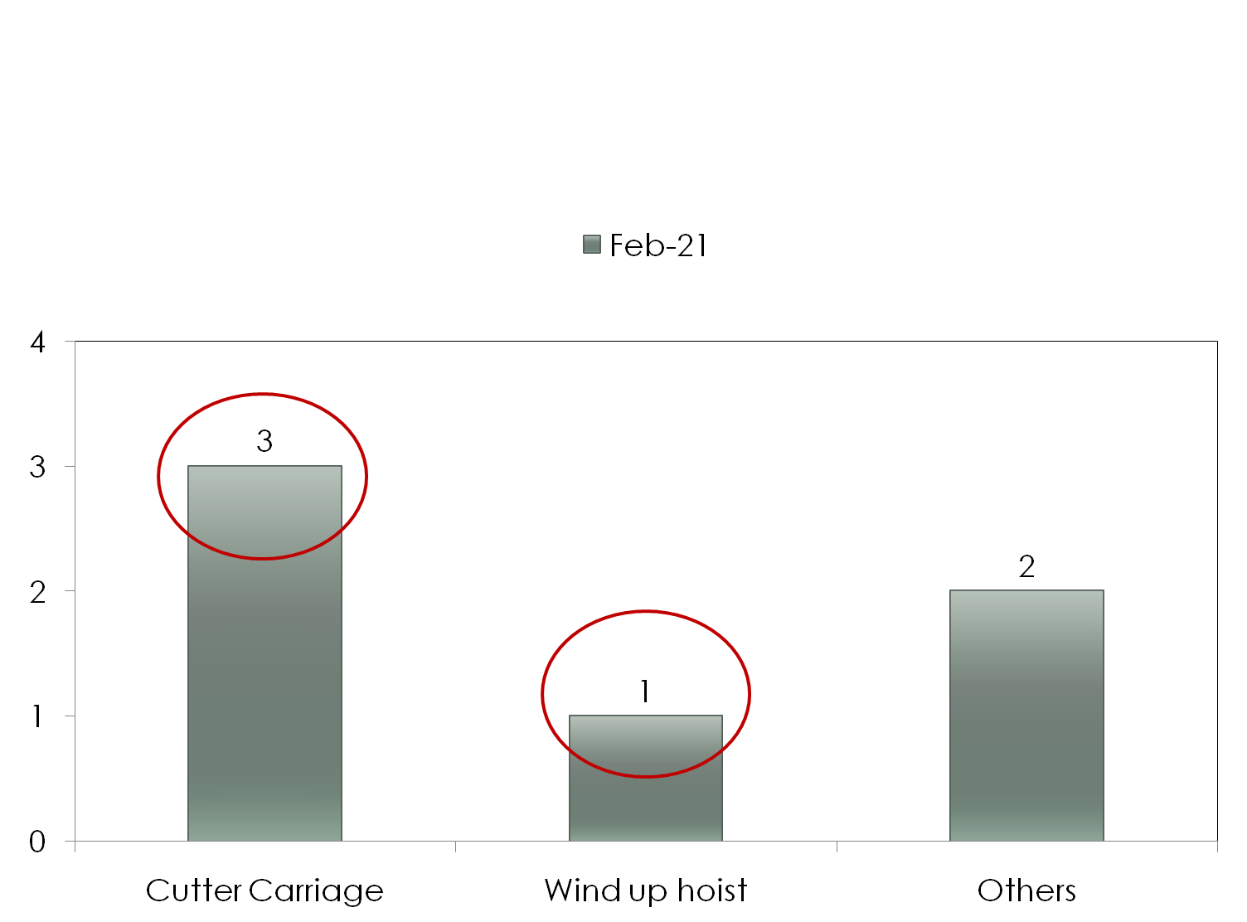
Phenomenon wise paratoo analysis for –High Table Banner cutter

Slide 9
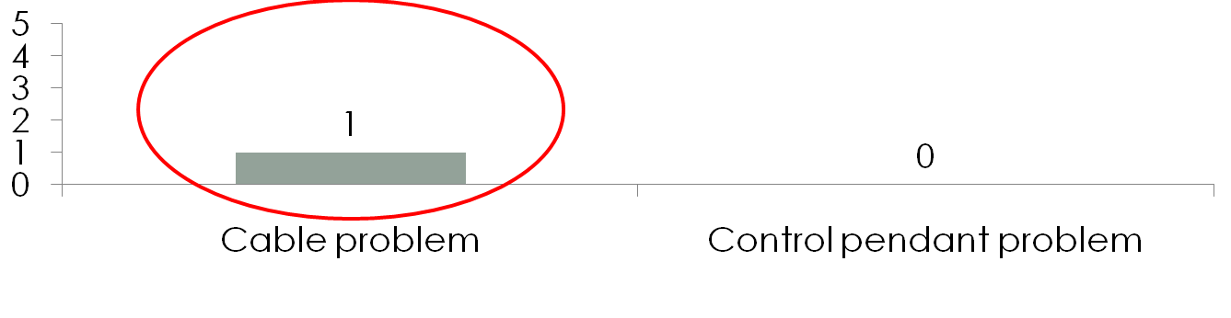
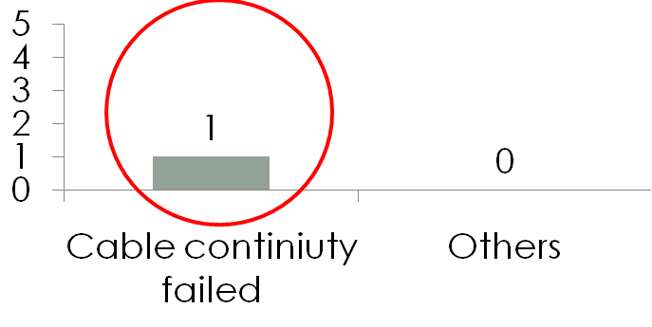
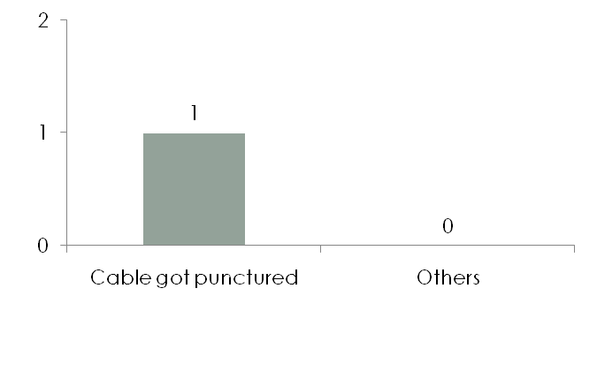
Part wise Paratoo for Wind up hoist problem-High table Banner
Sub part wise Paratoo for Cable problem
Root cause wise Cable continuity failed

Slide 10
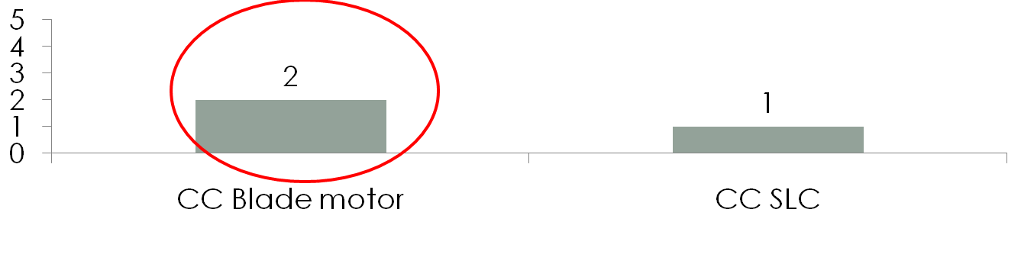
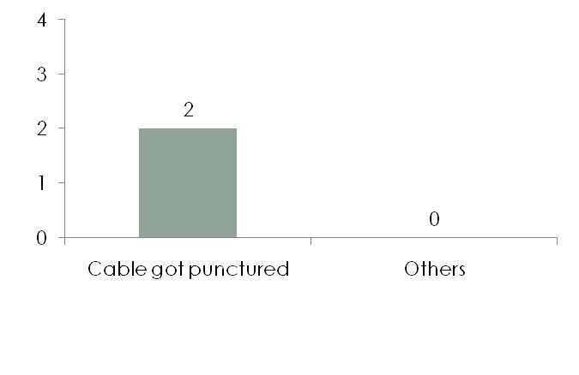
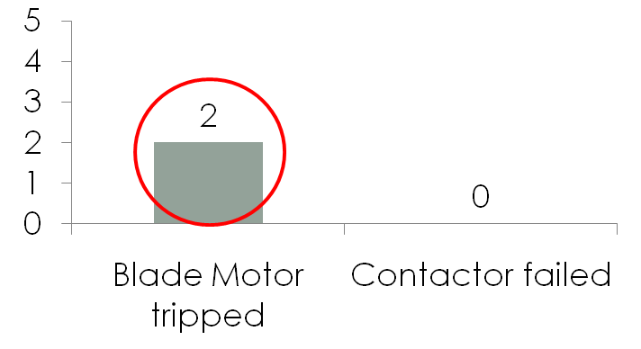
Part wise Paratoo for Cutter Carriage Problem-High Table Banner
Sub part wise Paratoo CC Blade motor
Root cause wise Blade motor tripped

Slide 11
Action plan for – BANNER CUTTER
Sl No | Defect / Break down | Phenomena | Root Cause | Corrective action proposed | Responsibility | Target date | Status/ Remarks
1 | Wind up hoist problem | Incomer Tripping during wind up hoist operating time | Wind up hoist cable got failed | Cable to be replaced | Kranthi/TLN Murthy | Immediate | Completed
2 | Cutter carriage problem | Knife motor MPCB tripping | Knife motor cable got punctured | Cable to be replaced | Kranthi/TLN Murthy | Immediate | Completed

Slide 12
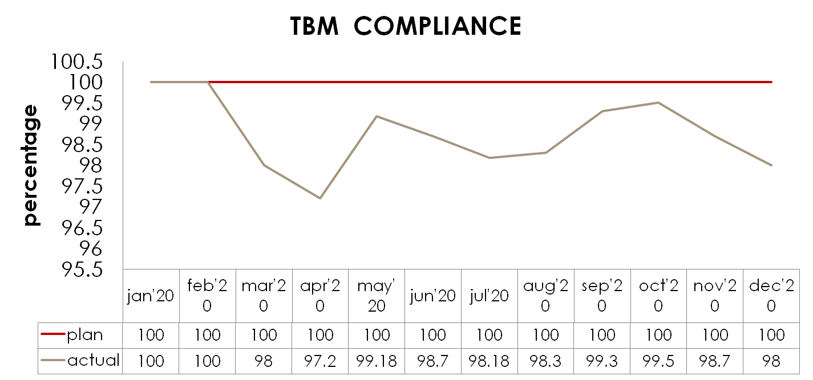
Department | ENGG | Process Measure | TBM-COMPLIANCE
Section | Banner cutter | Unit of Measurement | PERCENTAGE
Process Model Ref | S6

Slide 13


